Slide 1
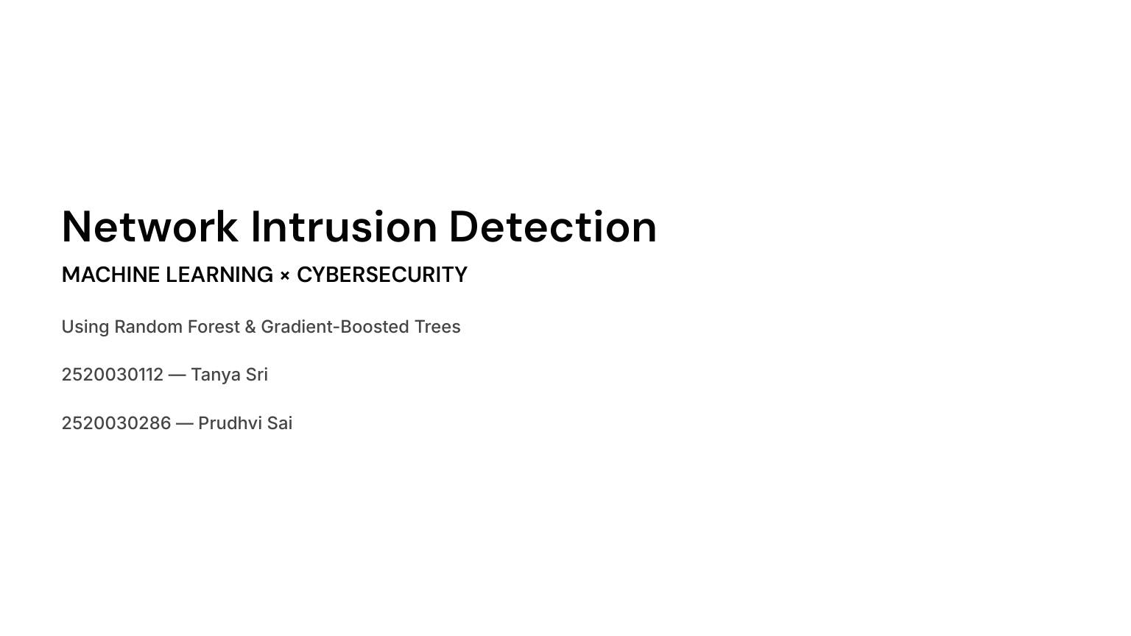
Notes:
Tanya Sri — Introduction
Good morning ma’am.
We are here to present our project titled “Network Intrusion Detection using Machine Learning.”
The main idea of our project is to use machine learning techniques to analyze network traffic and identify whether the traffic is normal or potentially malicious.
For this project, we are using two ensemble learning algorithms: Random Forest and Gradient-Boosted Trees.
I am Tanya Sri, and my teammate is Prudhvi Sai.

Slide 2
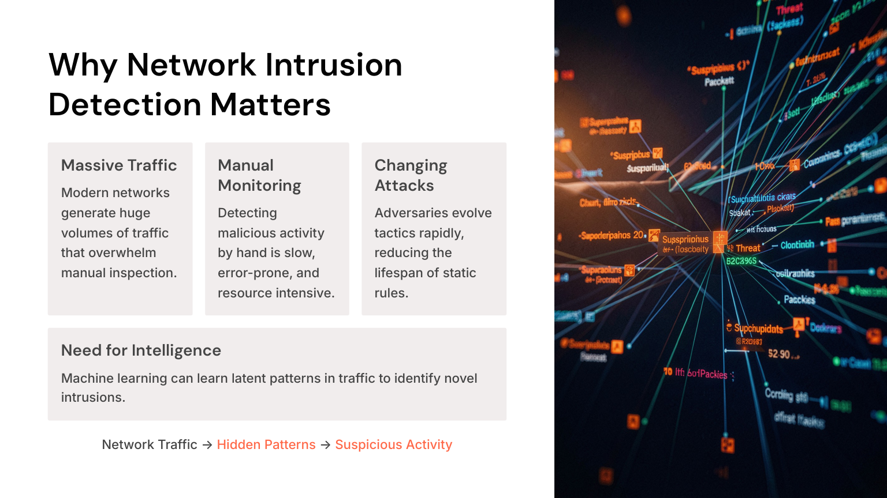
Notes:
Tanya Sri — Why Network Intrusion Detection Matters
Before going into the model, let us understand the problem.
Today, networks generate a very large amount of traffic. Checking all this traffic manually is difficult and time-consuming.
Also, cyber attacks are continuously changing. If we depend only on predefined security rules, a new or modified attack may not always be detected.
So, our approach is to use machine learning to learn patterns from network traffic and use those patterns to identify suspicious activity.
In simple terms: Network Traffic → Pattern Analysis → Normal or Intrusion.

Slide 3
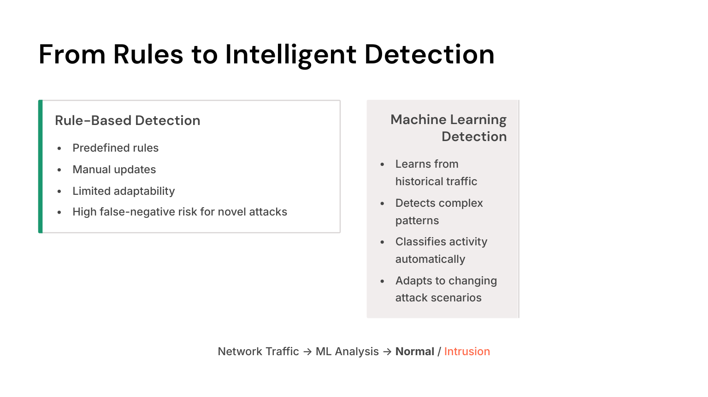
Notes:
Tanya Sri — From Rules to Machine Learning
Traditional intrusion detection systems generally depend on predefined rules.
For example, if a particular traffic pattern is already known to be malicious, a rule can be created to detect it.
The limitation is that these rules require manual updates and may not adapt well to changing attack patterns.
Machine learning takes a different approach. Instead of manually defining every possible attack, we provide historical network traffic to the model. The model learns patterns from that data and uses them to classify new traffic.
The main difference is: Rule-based detection depends on predefined rules, while machine learning learns patterns from data.

Slide 4
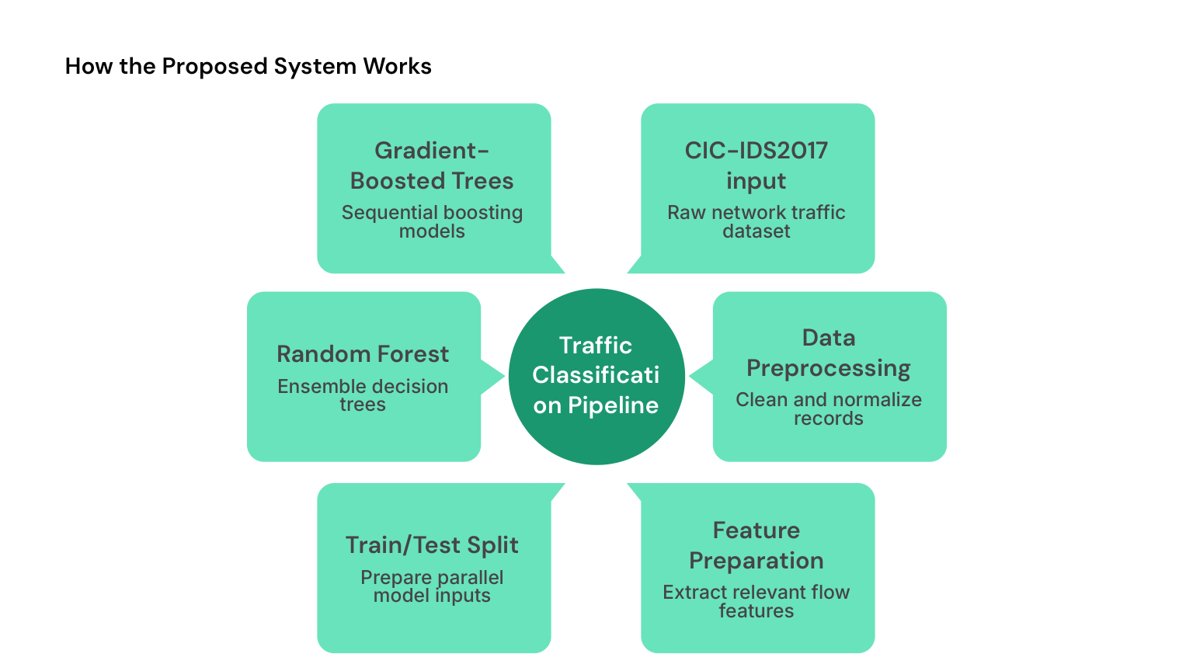
Notes:
Tanya Sri — Proposed System
This slide shows our proposed traffic classification pipeline.
We start with the CIC-IDS2017 dataset. Then we preprocess the data, prepare the relevant features, and split the data into training and testing sets.
After that, we apply two machine learning approaches: Random Forest and Gradient-Boosted Trees.
The purpose is to use the prepared network traffic features to classify activity as normal or intrusion.

Slide 5
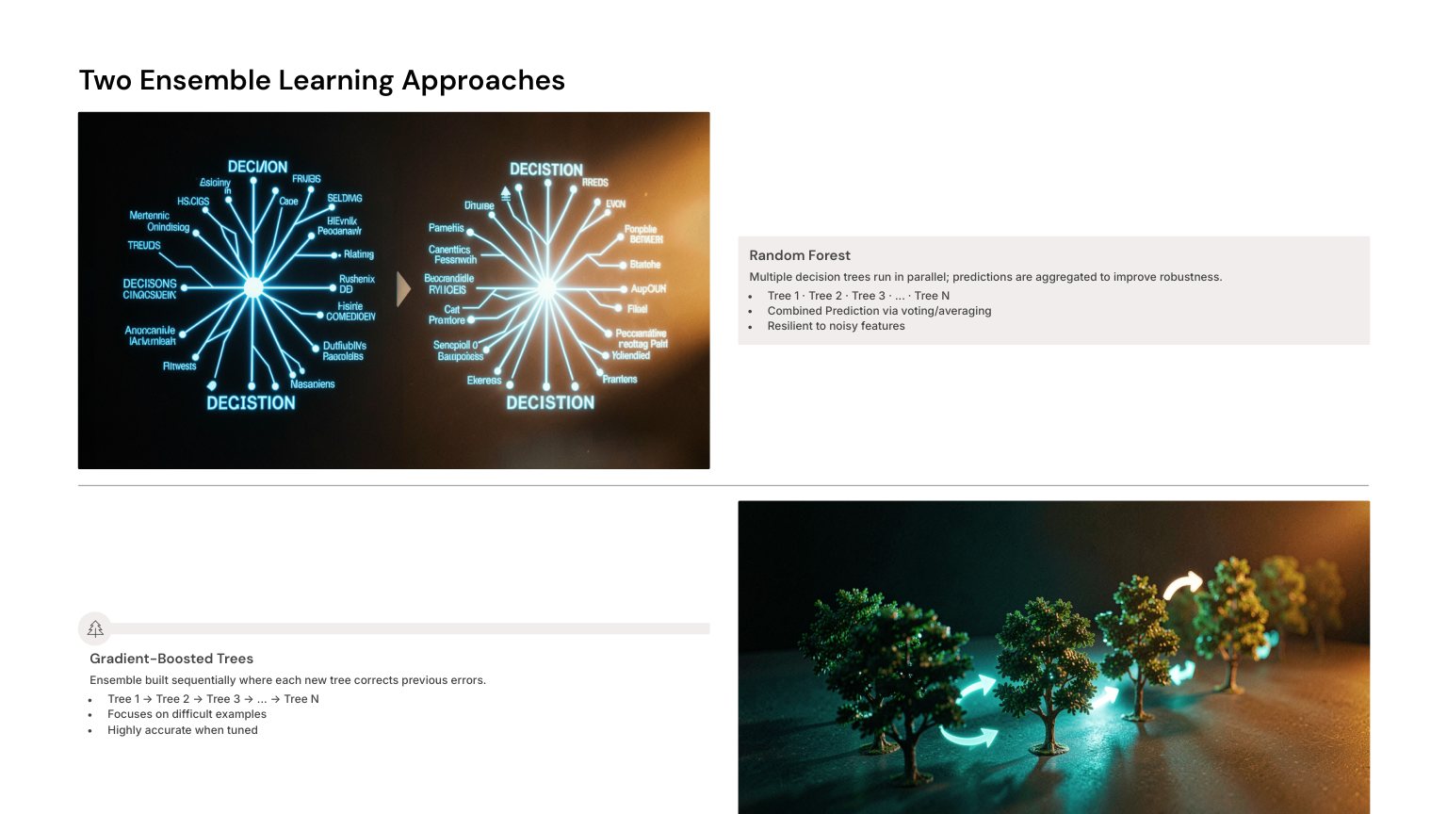
Notes:
Tanya Sri — Ensemble Learning Approaches
We use two ensemble learning approaches.
Random Forest uses multiple decision trees in parallel and combines their predictions through voting or averaging.
Gradient-Boosted Trees build trees sequentially, where each new tree tries to correct errors made by previous trees.
Both approaches combine multiple trees, but they build and combine those trees differently.

Slide 6
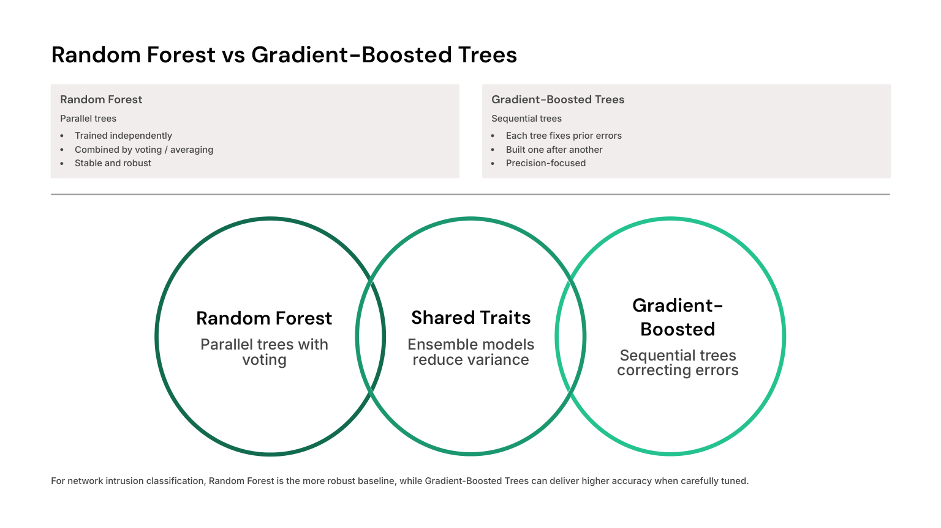
Notes:
Prudhvi Sai — Random Forest vs Gradient-Boosted Trees
Here we compare the two algorithms.
Random Forest builds multiple trees independently and combines their results through voting or averaging.
Gradient-Boosted Trees build trees one after another, with each new tree trying to correct the errors of previous trees.
Therefore, Random Forest represents a parallel ensemble approach, while Gradient Boosting represents a sequential error-correcting approach.

Slide 7
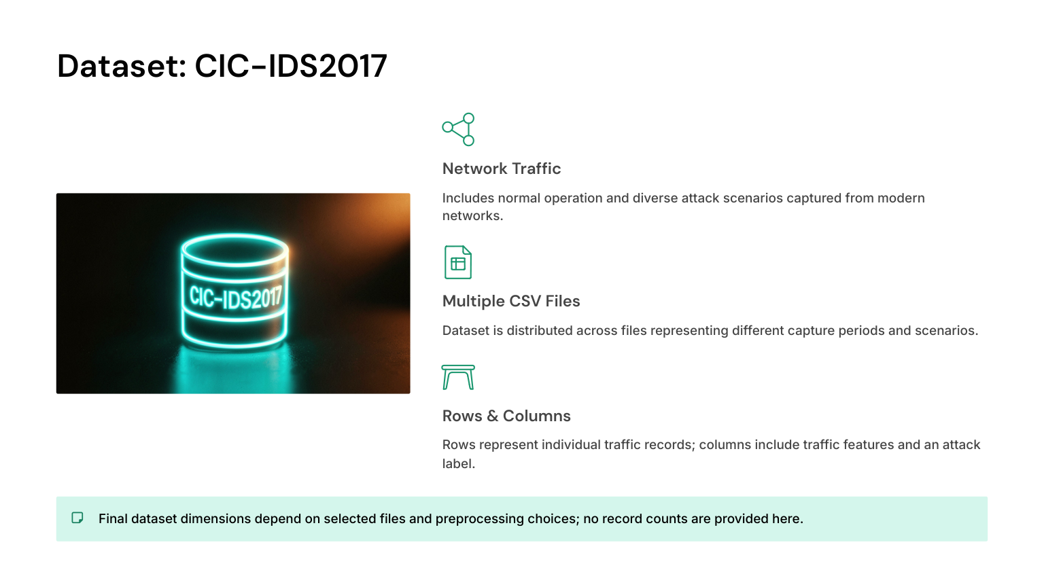
Notes:
Tanya Sri — Dataset: CIC-IDS2017
For our project, we use the CIC-IDS2017 dataset.
It contains network traffic representing both normal activity and different attack scenarios.
The dataset is available in multiple CSV files. Each row represents a network traffic record, while the columns contain different traffic features along with the attack label.
This dataset provides the input information required for our machine learning models.

Slide 8
Exploratory Data Analysis (EDA)
Understanding the dataset before preprocessing and model training
Dataset Structure
Data Quality
Rows, columns, traffic features and labels
Missing, invalid or inconsistent values
Feature Analysis
Class Distribution
Feature distributions and useful traffic patterns
Normal traffic versus attack traffic
Notes:
Tanya Sri — Exploratory Data Analysis (EDA)
Before training our machine learning models, we need to understand the dataset.
EDA stands for Exploratory Data Analysis. It is the process of examining the dataset to understand its structure, quality, and patterns before applying machine learning.
For our project, EDA should include checking the number of rows and columns, available traffic features, missing or invalid values, feature distributions, and the distribution of normal and attack traffic.
EDA is important because we should understand and prepare the data before giving it to a machine learning model.
Important: We have not included specific EDA numbers or graphs unless they were actually calculated from the dataset.

Slide 9
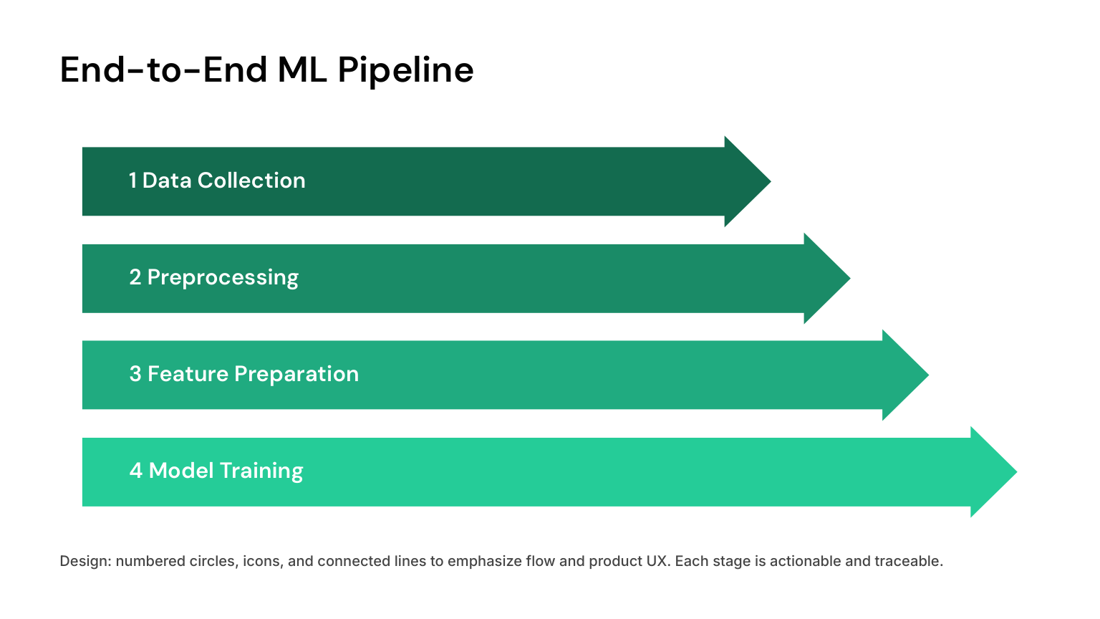
Notes:
Prudhvi Sai — End-to-End ML Pipeline
The complete machine learning pipeline has four main stages shown here: data collection, preprocessing, feature preparation, and model training.
In our expanded workflow, EDA comes before preprocessing so that we first understand the data.
After preprocessing, we prepare the relevant features and split the dataset into training and testing data.
The training data is used to build the models, while the testing data is used to evaluate them on unseen data.

Slide 10
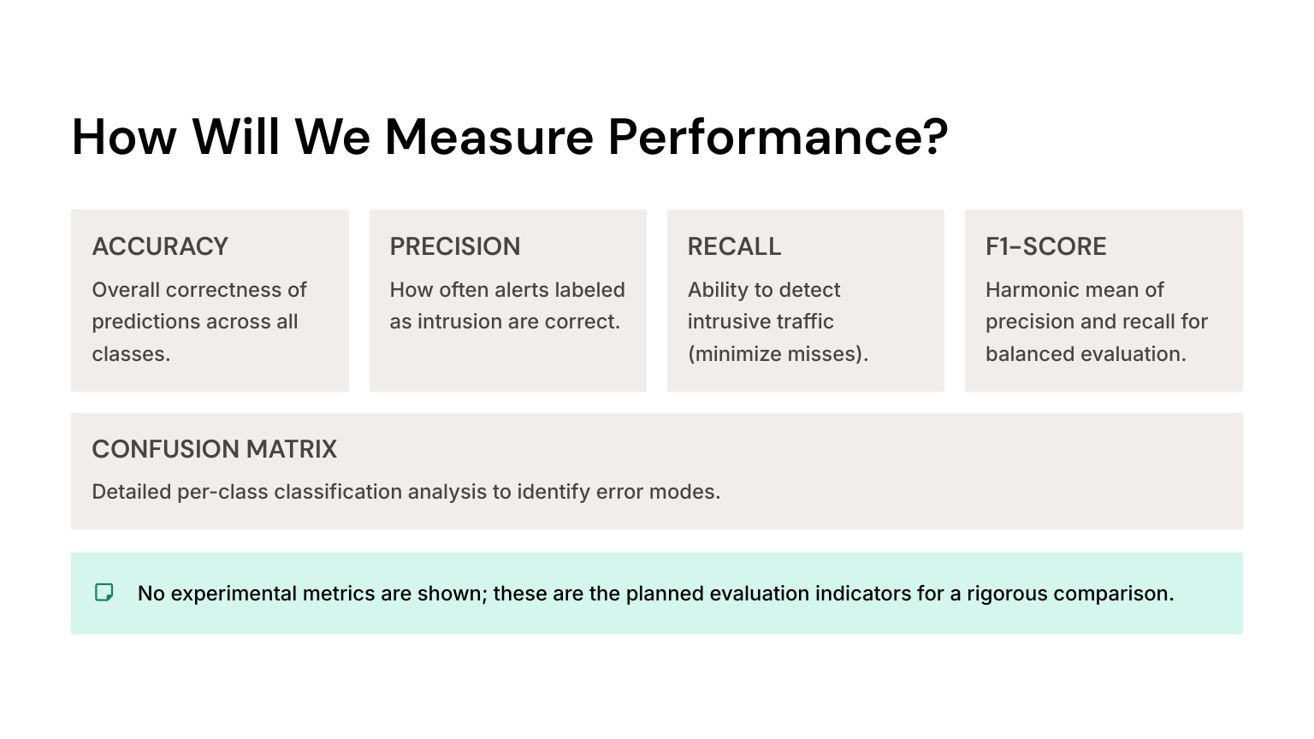
Notes:
Prudhvi Sai — Performance Measurement
After training the models, we need to determine how well they perform.
Accuracy tells us the overall correctness of predictions.
Precision tells us, when the model predicts an intrusion, how often that prediction is correct.
Recall tells us how effectively the model detects actual intrusive traffic.
F1-score combines precision and recall into a single measure.
A confusion matrix helps us understand the different correct and incorrect classifications.
These are the planned evaluation indicators; actual numerical results should only be stated after the models are trained and tested.

Slide 11
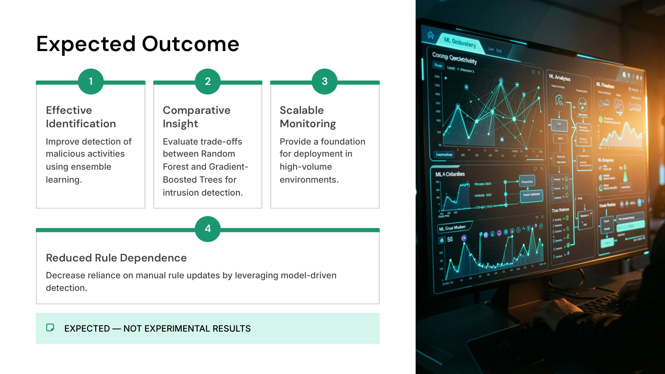
Notes:
Prudhvi Sai — Expected Outcome
The expected outcome of our project is to improve the identification of malicious network activity using ensemble learning.
We also aim to compare Random Forest and Gradient-Boosted Trees and understand their trade-offs for intrusion detection.
Another objective is to provide a foundation for scalable monitoring in high-volume environments and reduce dependence on continuously updated manual rules.
These are expected outcomes, not experimental results.

Slide 12

Notes:
Prudhvi Sai — Conclusion
To conclude, our project follows a complete machine learning workflow:
CIC-IDS2017 Dataset → EDA → Preprocessing → Feature Preparation → Train/Test Split → Random Forest and Gradient Boosting → Evaluation.
The main idea is to use machine learning to identify patterns in network traffic and classify suspicious activity.
By comparing two ensemble learning approaches, we can study their behavior for network intrusion detection.

